Slide 1
Public Health Principles for
School Reopening
For public use
Updated on July 24, 2020
By the Parabola Project

Slide 2
Why Do We Talk about Principles?
We establish core public health principles as the foundation from which we design our tools, interventions, and solutions. They are the “guardrails” within which we must stay and design safer re-entry options.
The principles are used in combination for health decisions around reopening.
No single principle will effectively lower risk alone, and we won’t be able to do all of these principles perfectly all of the time.
These principles work together to decrease the risk of transmission.
The more we follow these principles, the lower the risk.
We cannot reduce the risk of COVID transmission to zero. Some risk remains even with maximum adherence, especially if community transmission increases.
Notes:
(For example, 6 feet distance is safer than 5 which is safer than 4; wearing masks 90% of the time is better than 70% of the time)

Slide 3
A Balanced View of Risk
The decisions around the return to school must reflect a global view of risk. We must balance the risks of COVID-19 infection with in-school learning, with other significant risks to the overall health and well-being of our kids when they are out of school.
Loss of learning
Students could return in the fall already behind due to lack of in-person education, with up to 30% less reading learning and up to 50% less math learning compared to gains during a typical school year.¹
Nutritional insecurity
Some students depend on free/reduced-price meals provided in schools. Estimates suggest there will be an additional 1.2 to 6.8 million food insecure children in 2020 than there were in 2018.⁵
Social & emotional impact
In a US survey, 29% of parents said their children’s emotional and mental health were suffering due to social distancing and closures.² Additionally, 13% of adolescents in the US receive mental health care from their schools, with school being the only source of support for 35% of those children.³
COVID-19 Risk
Children under 10 tend to have milder cases of COVID-19 and current research suggests they spread the virus less than adults.⁹ Emerging research indicates that children 10 to 19 may transmit the virus similarly to adults.¹⁰
Loss of parental employment
Parents may be unable to work if they can’t find childcare options to replace school. Recent research suggests that if schools and daycares remain closed, 17.5 million workers, or 11% of the US workforce, may face major barriers to work.⁶
Reduced detection of child abuse
Teachers serve as mandatory reporters of child abuse and neglect. Hospitals across the country saw increases in child abuse injuries and deaths that coincided with lockdown orders.⁴
Lack of access to essential services
Across the US, about 1.5 million children have a diagnosed speech impairment⁷ and approximately 1 in 54 children have been diagnosed with autism spectrum disorders.⁸ These children, and others that require specialized supports, may have missed speech therapy and critical development services they previously received at school.
Notes:
Kuhfeld and Tarasawa. (2020). The COVID-19 slide: What summer learning loss can tell us about the potential impact of school closure on student academic achievement. Collaborative for Student Growth. https://www.nwea.org/content/uploads/2020/05/Collaborative-Brief_Covid19-Slide-APR20.pdf
Calderon. (2020). “U.S. Parents Say COVID-19 Harming Child's Mental Health” Gallup. https://news.gallup.com/poll/312605/parents-say-covid-harming-child-mental-health.aspx
Robson. (2020). “From their academic success to their social skills and mental health, the pandemic is a crisis for today’s children – and the fallout may follow them for the rest of their lives.” BBC. https://www.bbc.com/future/article/20200603-how-covid-19-is-changing-the-worlds-children
Kamenetz. (2020). “With School Buildings Closed, Children’s Mental Health Is Suffering.” NPR. https://www.npr.org/2020/05/14/855641420/with-school-buildings-closed-children-s-mental-health-is-suffering
Feeding America. (2020). “The Impact of the Coronavirus on Child Food Insecurity.” Feeding America. https://www.feedingamerica.org/sites/default/files/2020-04/Brief_Impact%20of%20Covid%20on%20Child%20Food%20Insecurity%204.22.20.pdf
Dingel, Patterson, and Vavra. (2020).Childcare Obligations Will Constrain Many Workers When Reopening the US Economy. Becker Friedman Institute for Economics at The University of Chicago. https://bfi.uchicago.edu/wp-content/uploads/BFI_WP_202046.pdf
Mitchell. (2020). “As Schools Close to Coronavirus, Special Educators Turn to Tele-Therapy.” Education Week. https://www.edweek.org/ew/articles/2020/03/31/as-schools-close-to-coronavirus-special-educators.html
National Center on Birth Defects and Developmental Disabilities. (2020). “Autism and Developmental Disabilities Monitoring (ADDM) Network.” Centers for Disease Control and Prevention. https://www.cdc.gov/ncbddd/autism/addm.html#:~:text=CDC%20estimates%20that%20about%201,the%20United%20States%20during%202016.
Wilson. (2020). Coronavirus: What does evidence say about schools reopening? Retrieved from https://www.newscientist.com/article/2241771-coronavirus-what-does-evidence-say-about-schools-reopening/; Boast, Munro, and Goldstein. (2020). An Evidence Summary of Paediatric COVID-19 Literature. Don’t Forget the Bubbles. Retrieved from https://dontforgetthebubbles.com/evidence-summary-paediatric-covid-19-literature/; Boulad, F., Kamboj, M., Bouvier, N., Mauguen, A., & Kung, A. L. (2020). COVID-19 in Children With Cancer in New York City. JAMA Oncology.; Li, W., Zhang, B., Lu, J., Liu, S., Chang, Z., Cao, P., ... & Chen, J. (2020). The characteristics of household transmission of COVID-19. Clinical Infectious Diseases.; Lee, B., & Raszka, W. V. (2020). COVID-19 Transmission and Children: The Child is Not to Blame. Pediatrics.; Munro, A. P., & Faust, S. N. (2020). Children are not COVID-19 super spreaders: time to go back to school. Archives of Disease in Childhood.; Ludvigsson, J. F. (2020). Children are unlikely to be the main drivers of the COVID‐19 pandemic–a systematic review. Acta Paediatrica.; Ludvigsson, J. F. (2020). Systematic review of COVID‐19 in children shows milder cases and a better prognosis than adults. Acta Paediatrica, 109(6), 1088-1095.
Park, Y. J., Choe, Y. J., Park, O., Park, S. Y., Kim, Y. M., Kim, J., ... & Lee, J. (2020). Contact Tracing during Coronavirus Disease Outbreak, South Korea, 2020. Emerging Infectious Diseases, 26(10).

Slide 4
The Principles Behind the Principles
What do we know today* about COVID-19 that impacts the health principles for school reopening?
Individuals can still transmit the virus before they show symptoms and even if they never develop symptoms.
Children under 10 tend to have milder cases of COVID-19 and current research suggests they spread the virus less than adults.
Emerging research indicates that children 10 to 19 may transmit the virus similarly to adults.
Schools so far do not appear to be main epicenters of COVID transmission.
Transmission seems to be related more to droplets in the air (e.g., when people cough, sneeze, talk, sing) than to touching contaminated surfaces (though both are important).
Transmission is decreased with greater physical distance, smaller gatherings, wearing face masks, and isolating at home when sick.
Basic public health practices (e.g., handwashing, disinfecting surfaces, immunizations) are critical to reducing spread of COVID-19 & other illnesses.
Notes:
*The knowledge base around COVID-19 is rapidly expanding by the day, meaning that our understanding of how the virus is transmitted and the best way to prevent and treat the illness changes rapidly too. Ariadne Labs is keeping up with the current science and using it to inform our work in real-time.

Slide 5
Parabola Project’s stance on four key areas
Masks: We believe everyone inside a school setting should be required to wear a mask/face covering, including pre-K-1 students.
Face-shields and barriers should not be used as a replacement for wearing masks/face coverings or physical distancing of 6 feet.
Distance: We believe a minimum of 6 feet should be the goal.
Cohort size: We believe a maximum of 25 people should be in a cohort, including both students and teachers.
Further rationale is provided on the subsequent slides.

Slide 6
We believe everyone inside a school setting should be required to wear a mask/face covering, including K-1 students.
States requiring mask-wearing in public are estimated to have prevented between 230,000-450,000 cases of COVID-19 between April and May 2020. (1)
A study among 9,850 health care workers at Mass General Brigham hospitals found that universal masking was associated with a significantly low rate of COVID-19 among health care workers compared to those who do not wear masks. (2)
A review of 19 randomized controlled trials found that universal mask wearing is important for preventing COVID-19, where transmission may occur before a person becomes symptomatic. (3)
Two hairstylists with COVID-19 in Springfield, MO saw 139 clients. The hairstylists and their clients all wore masks - none of the clients were infected with COVID-19. (4)
Notes:
References:
Lyu W, Wehby GL. Community Use Of Face Masks And COVID-19: Evidence From A Natural Experiment Of State Mandates In The US. Health Aff (Millwood). 2020 Jun 16;101377hlthaff202000818.
Wang X, Ferro EG, Zhou G, Hashimoto D, Bhatt DL. Association Between Universal Masking in a Health Care System and SARS-CoV-2 Positivity Among Health Care Workers. JAMA. 2020 Jul 14;
MacIntyre CR, Chughtai AA. A rapid systematic review of the efficacy of face masks and respirators against coronaviruses and other respiratory transmissible viruses for the community, healthcare workers and sick patients. Int J Nurs Stud. 2020 Aug;108:103629.
Hendrix MJ, Walde C, Findley K, Trotman R. Absence of Apparent Transmission of SARS-CoV-2 from Two Stylists After Exposure at a Hair Salon with a Universal Face Covering Policy — Springfield, Missouri, May 2020. MMWR Morb Mortal Wkly Rep. 2020 Jul 14;69(28).

Slide 7
We believe face shields should not replace masks/face coverings and barriers should not be used as a substitute for physical distancing.
Masks should be a priority. Face shields have limitations:
Face shields have limited ability to fully protect against droplets¹ and are not intended to serve as primary respirator protection.²
The CDC states that masks should also be worn with face shields.²
6 feet of physical distance should be a priority. Barriers may be useful when used in combination with with masks/face coverings and physical distancing.
Barriers may offer additional protection to staff who interact with many people, like front desk clerks and school nurses. They work best in locations where there is fixed and steady interaction with high numbers of people, and when regular cleaning can occur.
However, using barriers creates another surface to sanitize. Protocols will have to lay out who is responsible for cleaning the barrier, how frequently cleaning should be done, etc.
Notes:
References:
Bailar, J. C., Burke, D. S., Brosseau, L. M., Cohen, H. J., Gallagher, E. J., & Gensheimber, K. F. (2006). Reusability of facemasks during an influenza pandemic. Institute of Medicine of the National Academies.
Centers for Disease Control and Prevention. (2020). Operational Considerations for Personal Protective Equipment in the Context of Global Supply Shortages for Coronavirus Disease 2019 (COVID-19) Pandemic: non-US Healthcare Settings. https://www.cdc.gov/coronavirus/2019-ncov/hcp/non-us-settings/emergency-considerations-ppe.html

Slide 8
We believe that a minimum of 6 feet should be the goal in all settings and situations.
We recognize 6 feet cannot be maintained at all times, but if individuals come in contact closer than 6 feet an effort should be made to get back to 6 feet distance
Distance and risk are related - more distance above 3 feet reduces risk.
Older children are at higher risk than younger children, which makes distancing even more important for middle and high school children compared with younger children.
3 feet
6 feet
13% risk of transmission
3% risk of transmission
<3% risk of transmission
Notes:
Reference for The risk of transmission drops from 13% to 3% by physical distancing of 1 meter (3.3 ft), and distancing by more than 1 meter further decreases the risk of transmission:
Chu, D. K., Akl, E. A., Duda, S., Solo, K., Yaacoub, S., Schünemann, H. J., & COVID-19 Systematic Urgent Review Group Effort (SURGE) study authors. (2020). Physical distancing, face masks, and eye protection to prevent person-to-person transmission of SARS-CoV-2 and COVID-19: a systematic review and meta-analysis. The Lancet, 395(10242), 1973–1987. https://doi.org/10.1016/S0140-6736(20)31142-9

Slide 9
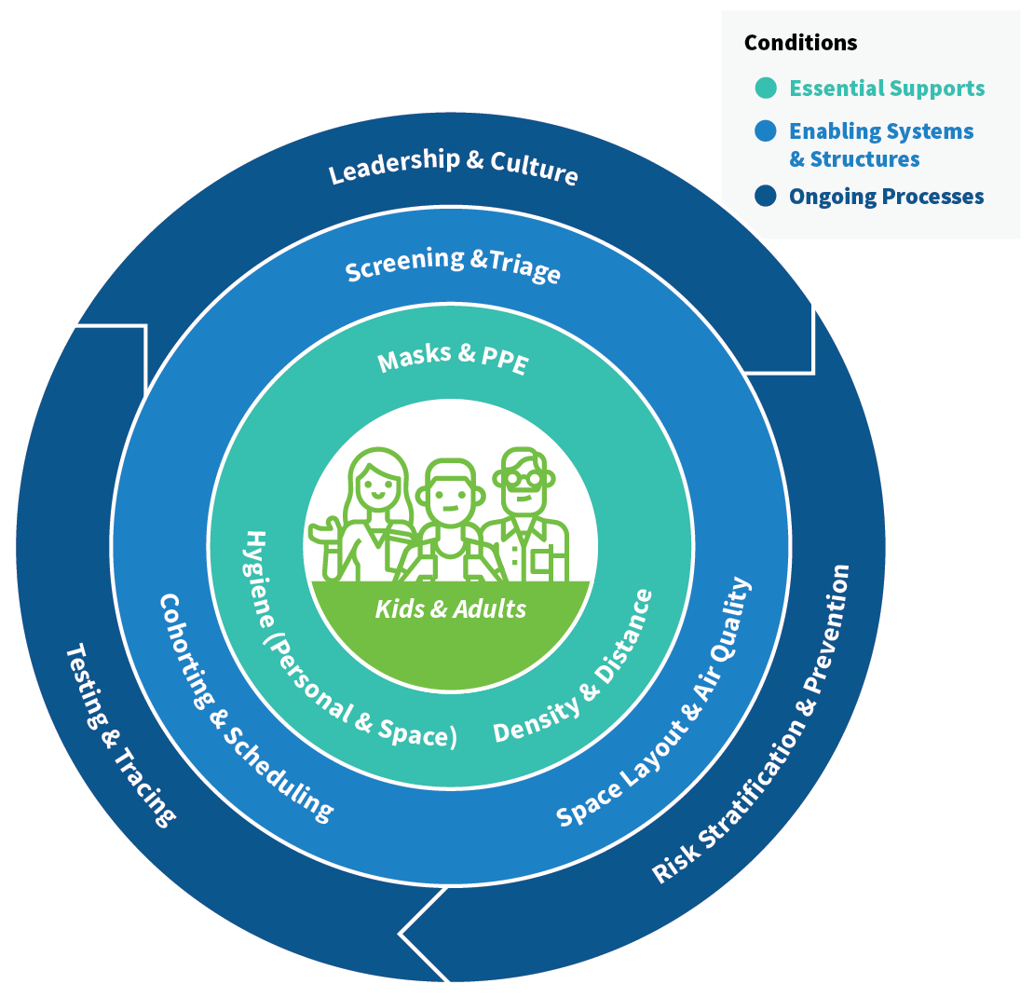
Principles at a Glance
Based on experience within the health care sector and other workplace environments, we have identified nine core public health principles that Ariadne Labs endorses for reducing risk of COVID-19 infection can be grouped as follows.
Notes:
These nine core public health principles that Ariadne Labs endorses for reducing risk of COVID-19 infection can be grouped as follows:

Slide 10
On Each Slide You Will Find
Name & description of the public health principle
→
Objectives that put the principle into action and a few initial details to show where to start
This content is pulled from the Parabola Project School Reopening Readiness Guide
→
NOTE: These slides do not cover the full extent of the who, what, when, where, why, and how of these principles, nor are they a fully exhaustive review of the evidence. We anticipate these components to be part of the next steps of our work incorporating and leveraging the guidance from the state.
Notes:
On each slide you will find illustrative examples

Slide 11
Leadership and Culture
Promote a leadership approach and culture around health that builds trust between leaders and the school community, makes agile data-driven decisions, takes a global view of health/education risks, and emphasizes resilience.
Develop a plan for clear and streamlined communication with families, staff, and the community
Establish and share your principles and plans for communication and stick to them.
Develop clear, transparent, and streamlined messages for families, staff, and the community. Train staff on these messages.
Use a variety of communication methods to engage with students, families, and staff. Determine and use consistent modes of communication (mail, email, text, virtual meetings) and employ a predictable and set cadence of communication.
Develop a plan for surveying families for essential information
Develop a survey, accessible in mobile and web formats, for families to collect data on readiness for return.
Send the survey to families as soon as you are able to allow time to react to the results.
Integrate the survey into your communication plan, include messages about the purpose of the survey and how it will support the plan to reopen.
Establish a partnership with the local health departments
Identify a point person at each district or school to partner with the local health department and establish regular communication.
Work with the local health department to summarize information about local testing options for families and staff.
Leverage state and local data such as local prevalence, positive testing rates, and hospitalizations to make decisions (e.g. sources: MA COVID-19 dashboard, local department of health)
Create a program for necessary student and staff training

Slide 12
Risk Stratification and Prevention Regular individual and family COVID-19 risk assessment to determine who can participate in in-person learning, facilitate access to key vaccines, and promote immune system strengthening practices.
Of note, children (especially ages 5-10) appear to be at lower risk of severe COVID-19 than adults.
Provide staff and families with information about risk in their primary languages to aid with decision making
Take a global view of risk: School policies should be guided by supporting the overall health and well-being of all children, adolescents, their families, school staff, and their communities.
Clearly communicate the global view with the community during all steps of the reopening process.
Establish clear guidance on groupings of staff and students who are at high risk of COVID-19 complications and thus should not join in-person learning, and pair this with clear plans for equitable supports for learning remotely.
Develop a strategy for health promotion and disease prevention for students and staff
Immunizations: Existing school immunization requirements should be maintained and not deferred because of the current pandemic.
Influenza vaccination: Although influenza vaccination is generally not required for school attendance, in the coming academic year, it should be highly encouraged for all students. School districts should consider requiring influenza vaccination for all staff.
Prioritize (don’t cut) needed health services for students, including behavioral and reproductive health, counseling services, and social/emotional supports.
Develop a plan to support high-risk staff and students who need to stay home
Provide details on risk factors to families and identify high-risk staff and students.
Staff age 65 or older, or with serious underlying health conditions that put them at high risk of illness due to COVID-19, should be encouraged to talk to their health care providers to assess their risk and to determine if they should avoid in-person contact in which physical distancing cannot be maintained.

Slide 13
Testing and Tracing Coordinate with local public health systems for school closures, for testing and quarantine of individuals with COVID-19 and for establishing protocols for public health system contact tracing for school community members who test positive for COVID-19.
Confirm plan for joint decision making with local health department regarding testing and school closure
Develop communication strategy between school district and local health department to facilitate COVID-related decision making.
Jointly develop a testing resource referral list to share with symptomatic or potentially exposed children and adults.
Clarify point persons in schools and Department of Health to facilitate contact tracing.
Create a district approach with the local department of health for when individual positive COVID-19 case or multiple cases are identified
Confirm protocol for informing and collaborating with local public health authorities (town, county, or state) to facilitate contact tracing, including those in close contact for at least 15 minutes (typically the entire classroom).
Collaborate with the local health department to define parameters for classroom or school closure due to a positive case or cases.
Develop communication plan for staff, parents/caregivers, and community when a positive case is identified (who, when, why?), including privacy policies regarding disclosure of COVD-19 status
Provide information for staff and families about how they can get tested
WIth local the Department of Health, identify local accessible and affordable testing options for children and adults to be tested for COVID-19 in the event of symptoms or exposure to people with COVID-19.
Provide education and a testing referral to the family of any student/staff who tests positive.
Confirm reporting and feedback mechanism for students/staff with positive testing results.

Slide 14
Screening and Triage Screen for symptoms of COVID-19 daily, stay home if any symptoms are present, and create space within the school for children and staff to isolate before going home if they develop symptoms during the school day.
Create a symptom screening process for students and staff to use each morning
Provide a checklist for use at home and school to review symptoms each morning and in a suspected case.
Assess if any materials require translation.
Incorporate the resource into your communication plans.
Ask parents and caregivers to screen their children each morning.
Encourage students and staff to stay home when sick, even without a doctor’s note.
Develop a school plan for what to do when a suspected COVID-19 case is identified
Designate an isolation space for suspected cases and protocol for interactions with that individual that reduce exposure.
Develop a protocol for sanitation of the isolation room.
Ensure isolation room has adequate ventilation that does not leak contaminated air into other spaces.
Ensure there is sufficient PPE for staff who will interact with the suspected case.
Determine what information will be provided to the students’ parent(s)/caregiver(s), when, and whether by phone or other means.

Slide 15
Space Layout and Air Quality Assess design and configuration of the school building and other spaces for adequate airflow, ventilation, and safer movement of people within and between spaces.
Prioritize ventilation, filtration, supplemental air cleaning, and regularly verifying HVAC system performance.
Ventilate with outdoor air as much as possible, even if it requires students to wear jackets in somewhat cold temperatures. Eliminate or minimize air recirculation.
Identify when your HVAC equipment was last inspected and schedule inspection if needed.
Inspect HVAC air filters to make sure they’re installed and fit correctly and that airflow is maintained across the filter.
Identify and vet additional space
Assess if other rooms and common areas within the school can be repurposed as classrooms while maintaining separation of cohorts and physical distancing (e.g., cafeterias, libraries, gyms).
Aim to limit cohorts to approximately less than 25 people, inclusive of students and teachers.
If considering placing multiple cohorts in the same large space, consider constructing floor-to-ceiling walls to separate large spaces into fully contained ones. Curtains, mobile whiteboards, and smaller plexiglass dividers are likely not sufficient.
De-densify hallways and bathrooms
Make hallways one-way. Use arrows on the floor and walls to denote the direction of the hallway. Consider ways to decorate the arrows (e.g., bright colors or school colors, include images of cartoon characters or school mascot, etc.).
If hallways cannot be made entirely one-way (e.g., because of dead ends, fire exits, etc.), create lanes on the floor showing which direction to move. Affix corresponding arrows to the floor and walls.

Slide 16
Cohorting and Scheduling Group limited numbers of students and staff, keep the same individuals together in each group, and limit inter-group contact to reduce the number of individuals exposed to each other.
Develop a plan for how cohorts will be formed and scheduled
Cohorts should stay together throughout the day and be consistent day to day.
Aim to limit cohorts to approximately 25 people (inclusive of students and teachers).
Determine the maximum capacity for all indoor enclosed spaces while maintaining 6 feet physical distancing space.
Evaluate cohorts for equity, ensuring configurations allow for students to access high-quality instruction, needed supports, inclusion in general education spaces, and a representative group of peers.
Determine when cohorts will be in-person vs. virtual in a hybrid (mix of virtual and in-person) model.
Restrict access to school grounds and communicate restricted access to community members
List who is allowed on school grounds and who is not allowed without invitation.
Include the lists in communication to teachers, parents/caregivers, and community members.
Clearly mark entrances with the “allowed list” and a number to call for more information.
Designate alternative entrances for vendors.
Identify extracurricular activities that can resume in a responsible way
Determine whether certain clubs can be conducted virtually.
Assess safety of restarting school sports.
Evaluate before- and after-school programs for space and feasibility within CDC and state guidelines.
Modify or cancel classes and extracurriculars where large numbers of students will be in close contact (e.g. string orchestra, student government meetings) and/or will be engaged in activities that result in excessive aerosol production (e.g. band with woodwind or brass instruments, chorus).

Slide 17
Masks and PPE Require all children and staff to wear a cloth or medical mask at all times and make appropriate personal protective equipment (PPE) available for nurses and individuals assessing or treating a suspected case.
Develop a clear and aligned message about masks
Students (and staff) of all ages should wear masks throughout the day, including on the bus and outside if distance can’t be maintained.
Note: masks for ALL ages is best practice. Some places and countries have allowed Pre-K and Grade 1 to be exempt. However, all ages must wear masks on school buses.
Establish guidance for families, local health care providers, and staff as to what constitutes a mask exception
Communicate key messages about mask exceptions to families, local health care providers, and staff.
Distribute information for families and staff on proper use, removal, and washing of cloth face coverings
Use different modes of communication and messaging regarding mask recommendations (mail, email, text, social media, school website, infographics).
Evaluate inventory and purchasing of health care supplies
Establish health care supply processes, including vendors, budget, storage space, and inventory management for disposable masks and PPE.
Establish a protocol for mask breaks that allows for 6 feet distancing

Slide 18
Hygiene (Personal and Space) Clean hands (via hand-washing, sanitizing), clean and wipe down surfaces, and conduct deep cleaning of building spaces to reduce exposure to COVID-19 droplets.
Develop a plan for hand-washing/sanitizing throughout the school day
Prepare a schedule for hand-washing/sanitizing.
Place hand sanitizer in key locations in the building (e.g., entryways, bathrooms, classrooms).
For each school, determine the quantities needed of soap and hand sanitizers, paper towels, and automatic soap/sanitizer dispensing units.
Identify and contact suppliers to order supplies.
Establish a plan for effective sanitization
Define roles and responsibilities about who will be responsible for cleaning designated areas.
Determine how frequently various surfaces will need to be cleaned, including manipulatives (e.g., toys, equipment).
Develop a protocol for classroom/school cleaning and disinfecting when a positive COVID-19 case (student or staff) is identified.
For each school, determine the quantities needed of cleaning solutions and supplies, and protective equipment for custodial staff.
Determine if each class has adequate supplies to minimize use of and properly sanitize high-touch and shared supplies
Ensure each student has their own supplies. Maintain separation of individual students’ belongings.
If objects must be shared, develop a cleaning protocol for disinfecting shared supplies between uses.
Provide disposable disinfectant wipes for individuals to use before using shared objects.
If requesting families to provide materials, develop a process for purchasing and allocating supplies to families most in need (e.g. qualifying for free/reduced lunch).

Slide 19
Density and Distance Limit the number of people in enclosed spaces and allow distance between people to reduce exposure to COVID-19 droplets.
Develop a protocol for distancing on buses
Determine whether additional buses/trips/routes are necessary to accommodate distancing.
Develop a plan to reduce class sizes to allow for sufficient distancing in classrooms
Measure classrooms and determine class size capacity.
While some guidelines (such as WHO and other countries) suggest a distance of at least 3 feet, we suggest that the aim is to maintain a distance of 6 feet between individuals as much as possible. Distance and risk of transmission is a continuum — more distance is associated with reduced transmission.
Plan for staggered drop-off/pick-up of students
Stagger drop-off and pick-up times and location by student cohorts (Arizona Department of Education 2020).
Evaluate classes that require modification due to higher risk or other activities (PE and recess, band, chorus, etc)
Identify alternative activities.
Create a protocol for meals that allows for 6 feet distancing
Avoid having large groups in the cafeteria by eating meals in the classroom or outside.
Ensure that 6 foot distancing is maintained when eating. This is particularly important given that masks will be temporarily removed for eating.

Slide 20
More resources from the Parabola Project
School Reopening Readiness Guide: detailed implementation options to assist district and school leaders in developing, assessing, and executing their operational plans and assessing readiness to reopen schools for in-person learning.
Mask Guidance:
Choosing & Wearing Masks During COVID-19 (PDF)
Creating & Reusing Masks During COVID-19 (PDF)
Evidence that Masks Work During COVID-19 (PDF)
Mask Culture Toolkit
Coming soon:
Support for Family and Staff Communications
Support for If and When to Close
Building and Space Assessments
How to Care for Your Classroom

Slide 21
Appendix

Slide 22
Public Health Principle Definitions
Leadership and Culture Promote a leadership approach and culture around health that builds trust between leaders and the school community, makes agile data-driven decisions, takes a global view of health/education risks, and emphasizes resilience.
Risk Stratification and Prevention Regular individual and family COVID-19 risk assessment to determine who can participate in in-person learning, facilitate access to key vaccines, and promote immune system strengthening practices. Of note, children (especially ages 5-10) appear to be at lower risk of severe COVID-19 than adults and older teenagers.
Testing and Tracing Coordinate with local public health systems for school closures, for testing and quarantine of individuals with COVID-19 and for establishing protocols for public health system contact tracing for school community members who test positive for COVID-19.
Screening and Triage Screen for symptoms of COVID-19 daily, stay home if any symptoms are present, and create space within the school for children and staff to isolate before going home if they develop symptoms during the school day.
Space Layout and Air Quality Assess design and configuration of the school building and other spaces for adequate airflow, ventilation, and safer movement of people within and between spaces.
Cohorting and Scheduling Group limited numbers of students and staff, keep the same individuals together in each group, and limit inter-group contact to reduce the number of individuals exposed to each other.
Masks and PPE Require all children and staff to wear a cloth or medical mask at all times and make appropriate personal protective equipment (PPE) available for nurses and individuals assessing or treating a suspected case.
Hygiene (Personal and Space) Clean hands (via hand-washing, sanitizing), clean and wipe down surfaces, and conduct deep cleaning of building spaces to reduce exposure to COVID-19 droplets.
Density and Distance Limit the number of people in enclosed spaces and allow distance between people to reduce exposure to COVID-19 droplets.

